Slide 1
Getting Started with FT8 on the HF Bands
By John Bartos, AB3LZ

Slide 2
What is FT8?
A form of digital communications derived from software developed by Joe Taylor, K1JT, for Moon-bounce (EME) applications where signals are extremely weak (VHF/UHF).
Uses sophisticated digital signal processing
Also relies on redundancy – it sends the information over and over

Slide 3
Who is Joe Taylor (K1JT)
Licensed as a teenager (K2IPT).
A math wiz whose interest in radios led to a career in radio astronomy.
Co-discoverer of the first pulsar in a binary system.
Tracked shrinking orbit of this binary system for 30 years.
Orbit was shrinking due to mass transfers.

Slide 4
Who is Joe Taylor (K1JT)
Proved the orbit shrinking and mass loss was due to gravitational radiation.
Predicted by Einstein's Theory of General Relativity to an accuracy of 1%.
First to prove the existence of gravitational radiation.
Awarded the Noble Prize in physics in 1993.
Retired physicist/professor but still an active ham working on weak signal recognition.

Slide 5
WSJT (Weak Signal Joe Taylor)
Program written by K1JT to facilitate weak signal VHF/UHF communications.
Supported 4 communication protocols:
FSK441: for meteor scatter
JT6M: for ionospheric scatter
JT-65: for EME at VHF/UHF and for HF skywave propagation
JT4: For EME and tropospheric propagation on microwave bands
Not user friendly.

Slide 6
WSJT-X
Developed a suite of weak signal digital recognition programs (modes) that are included in WSJT-X.
Aimed at HF use with a simplified GUI.
The first popular mode was JT65.
Later added JT9, WSPR, FT8 and FT4.
Subsequent modes improved performance:
Narrower bandwidth
Shorter sequence interval
Improved signal detection sensitivity

Slide 7
WSJT-X
Programs available for Windows and MAC OS.
Source code is available to compile on LINUX operating systems.

Slide 8
65 Different Tones
A 1270.5 Hz synchronizing tone
64 additional tones to carry the information (FSK)
On the air it sounds like someone playing music

Slide 9
Timing is Everything
Each JT65 transmission lasts precisely 46.8 seconds.
During transmission only a small amount of information is sent – about 13 characters
Station clocks must agree within about 1 seconds (Accurate time is important)
As much as 80% of the transmission can be lost and still be decoded

Slide 10
Taking Turns
Stations take turns transmitting
Stations transmit on even or odd UTC minutes, and then listen on the following minutes

Slide 11
Just the Facts!
A JT65 contact is designed to exchange the bare minimum information needed to qualify as a “QSO”
Call signs
Signal Reports
Grid Squares

Slide 12
Transmitting and Receiving by Turns – Typical QSO

Slide 13
Contacts by the “Colors”
WSJT-X uses color highlighting to indicate which stations are calling CQ, which stations are in contact with each other, and which stations are transmitting to you.
The program also has preformatted responses that you can send by simply double clicking on the appropriate line.
Colors are customizable.

Slide 14
JT9 on the HF Bands
Functionally similar to JT65
Differences:
9 tones in lieu of 65.
BW of 15.6 HZ in lieu of ~185 HZ.
JT65 decoder clamped at -1dB and JT9 decoder good to +49dB. (JT9 decoder linear over a large range)
JT65 S/N threshold is -25dB vs. the JT9 threshold @ -27dB.
Software operation identical for both modes.
Still required 50 second transmit/receive intervals.
About 3 seconds for decoding and 7 seconds for operator action.
About 5 – 6 minutes for a QSO (slow).

Slide 15
FT8
FT8 developed to address slow speed issues with JT65 & JT9.
Developed by Joe Taylor and Steven Franke.
Rolled out in WSJT-X Version 1.8.0.
Uses 15 second T/R sequences.
50% or better decoding probability down to -20 db (more sensitive).
QSOs are 4 times faster.

Slide 16
FT8 Characteristics
Important characteristics:
15 second T/R sequence length
Message length: 75 bits + 12-bit CRC
Modulation: 8-FSK. Tone spacing 6.25 HZ
Bandwidth: 50 HZ
Transmission duration: 12.64 seconds
Optional auto-sequencing and auto-reply to a CQ response
Multi-decoder finds and decodes all FT8 signals in the passband
Operational behavior similar to JT9 and JT65
Transmission speed equivalent to 5 wpm CW.

Slide 17
FT8 Waterfall & FFT

Slide 18
WSJT-X Water Fall Plots
FT8 Water Fall & FFT

Slide 19
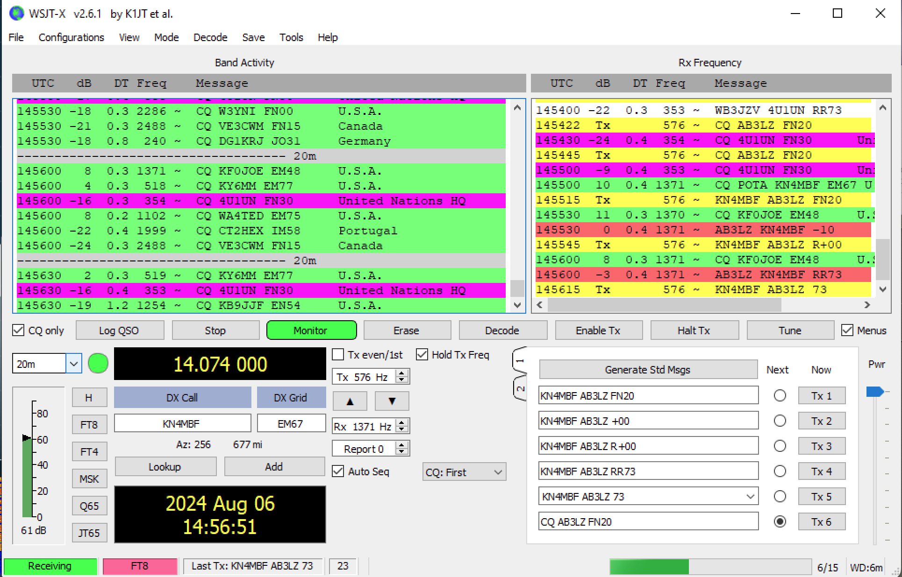
WSJT-X Control Panel

Slide 20
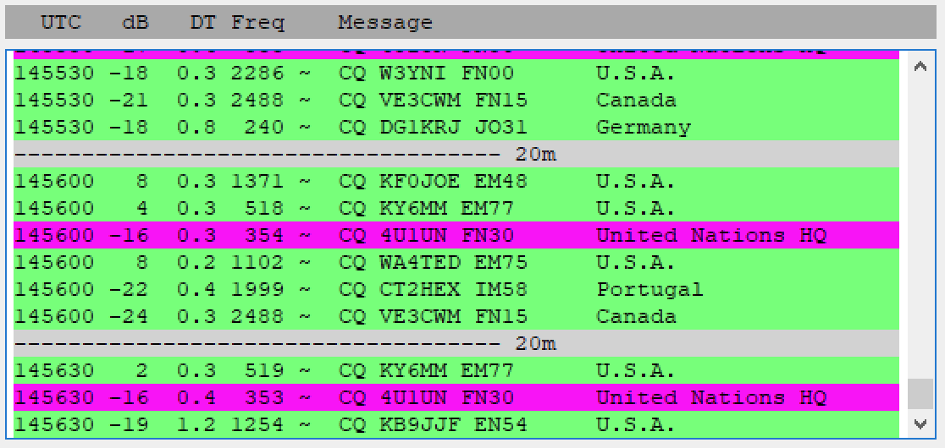
Understanding the WSJT-X Decoding Screen
UTC – When the signal was received.
dB - The strength (S/N) of the received signal in dB. Higher is better.
DT – The calculated offset of the received signal from your local clock. Values of .3 to 1.9 are typical.
Freq – Offset in Hz from the center point (0).
Message – Information exchange.
Geographic Location

Slide 21
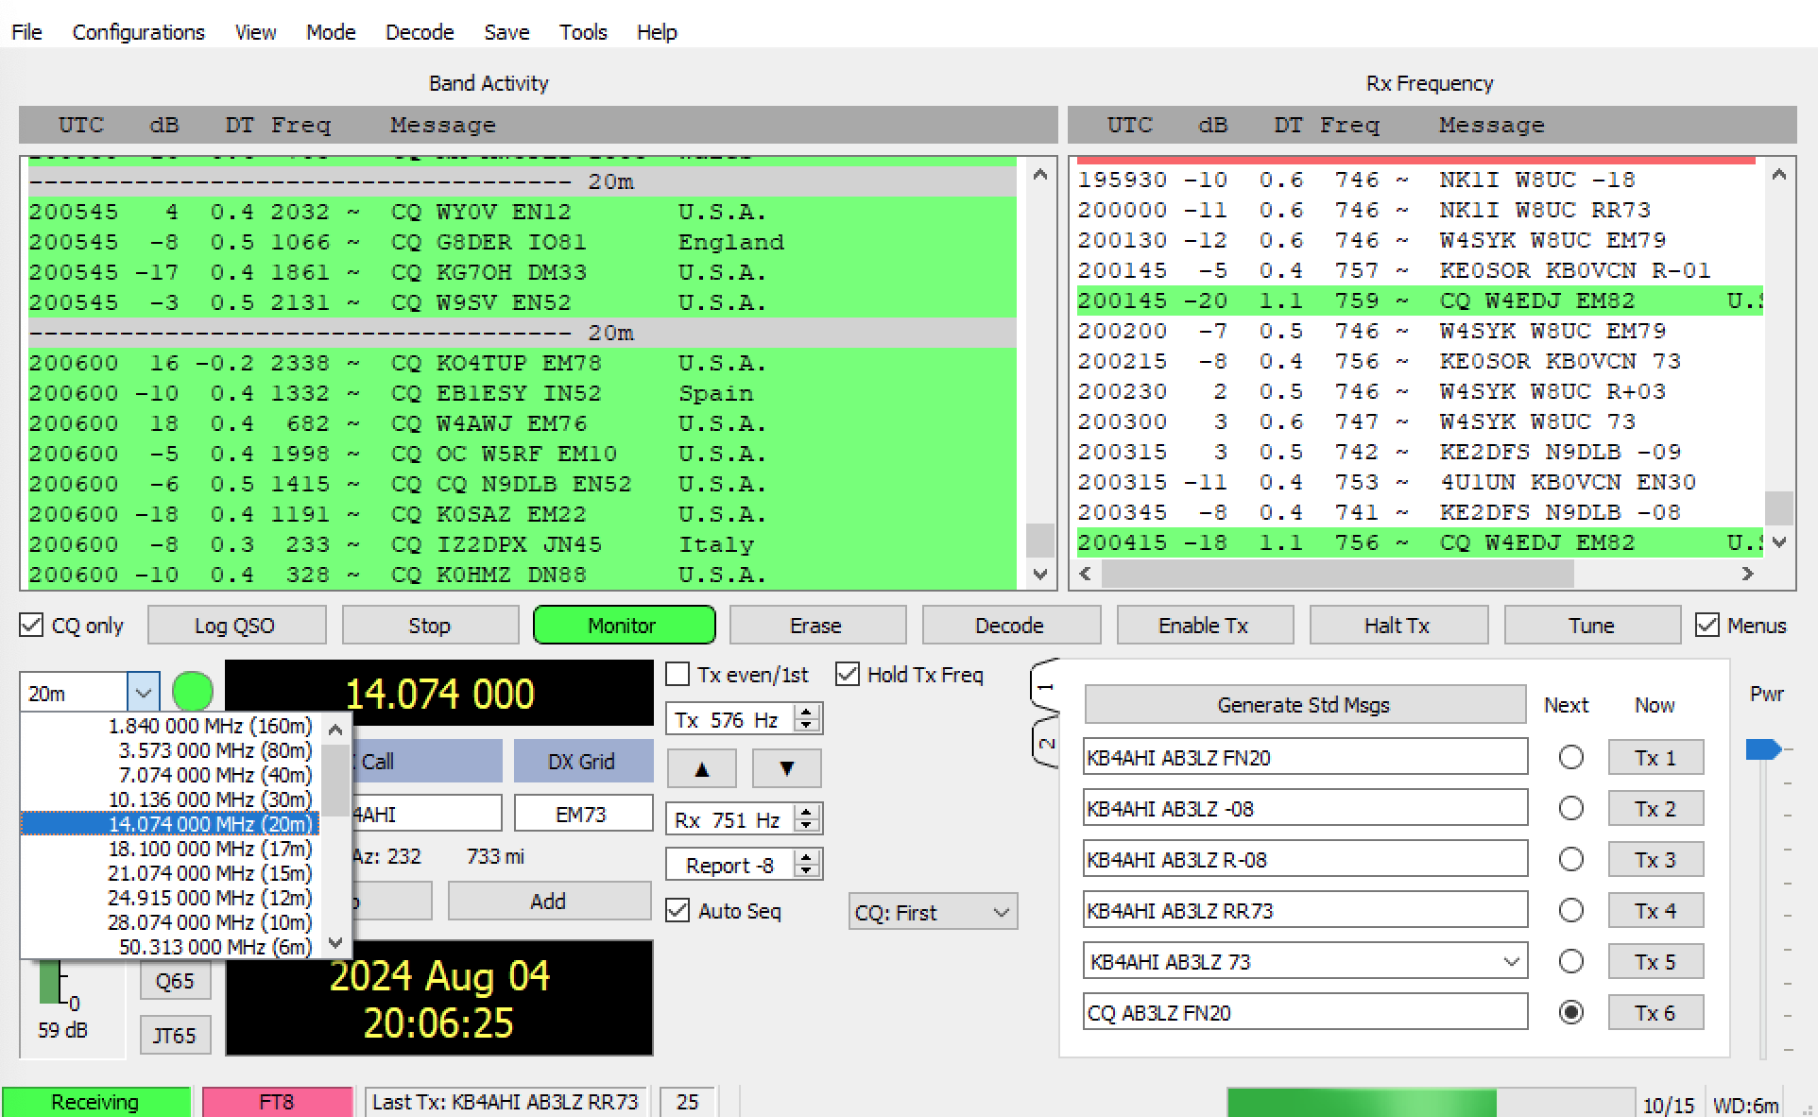
Band Selection

Slide 22
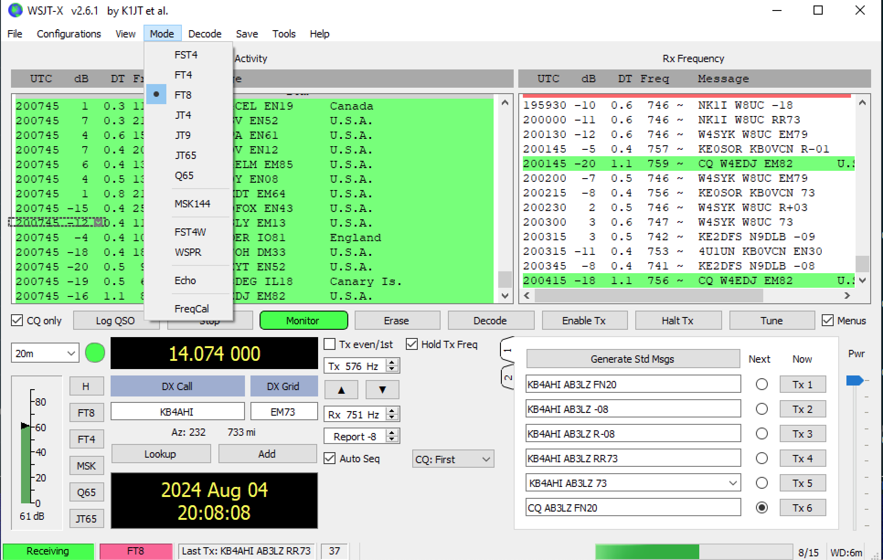
Mode Selection

Slide 23
Automatic Sequence

Slide 24
Logging

Slide 25
FT8 Contacts Are Valid For Awards
Also supported by ARRL’s Logbook of The World
DXCC
Digital DXCC
Worked All States
Worked All Continents
eQSL Awards
Field Day Credits

Slide 26
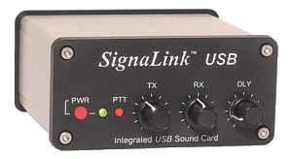
What Do You Need to Try FT8
SSB Transceiver
Computer with sound device
Interface
SSB Transceiver with built in sound card

Slide 27
Download and Install the WSJT-X Free Software
WSJT-x
https://wsjt.sourceforge.io/wsjtx.html
Clock Programs (Time is Important)
http://www.satsignal.eu/ntp/setup.html (Meinberg NTP)
http://www.thinkman.com/dimension4/

Slide 28
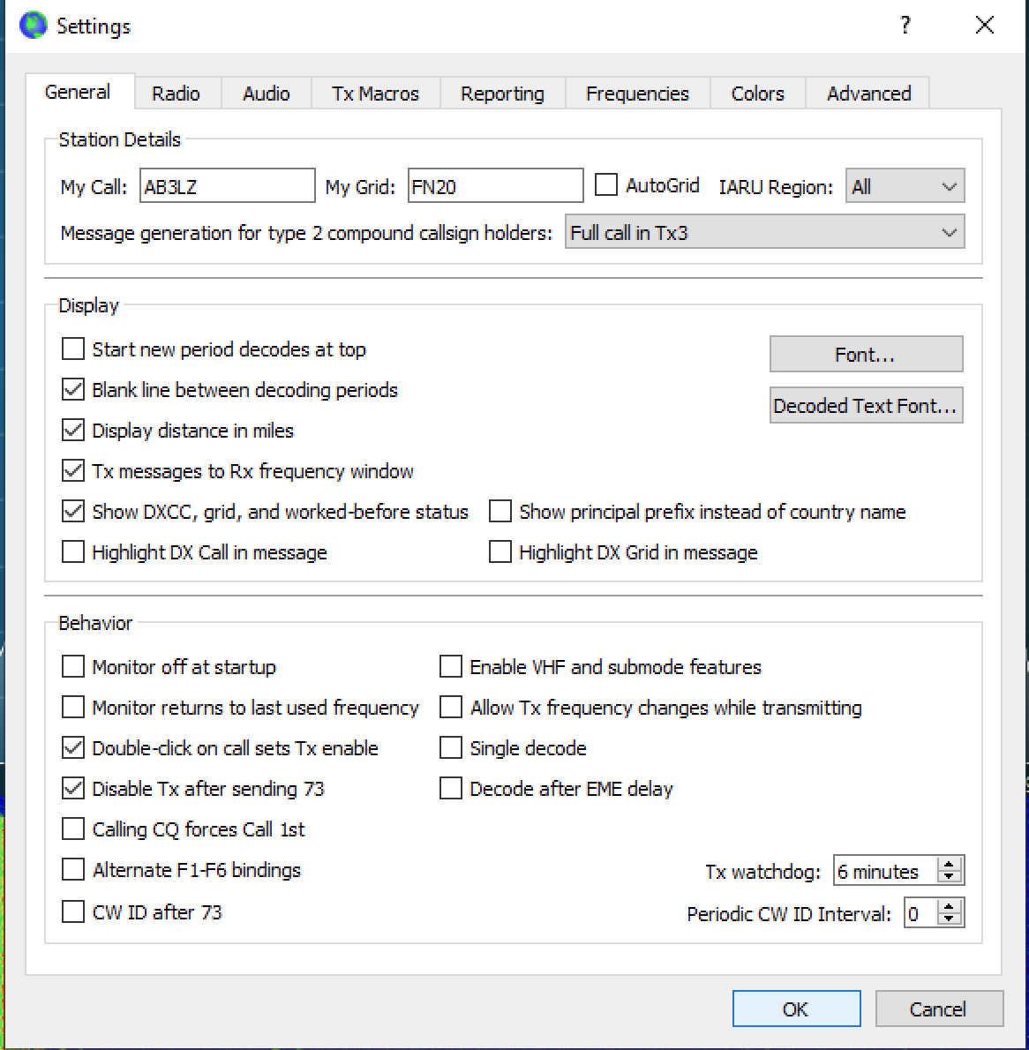
Configure the Software First

Slide 29
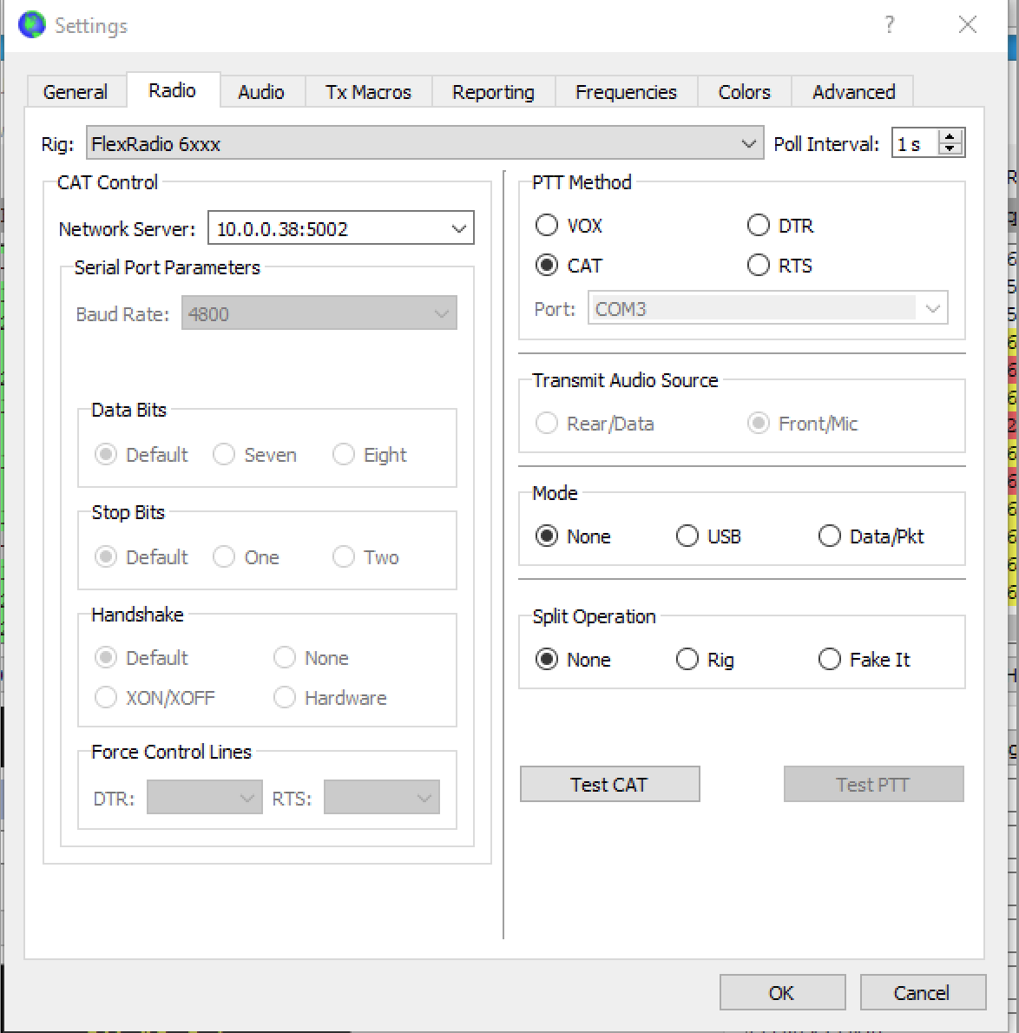
Configure the Radio Settings

Slide 30
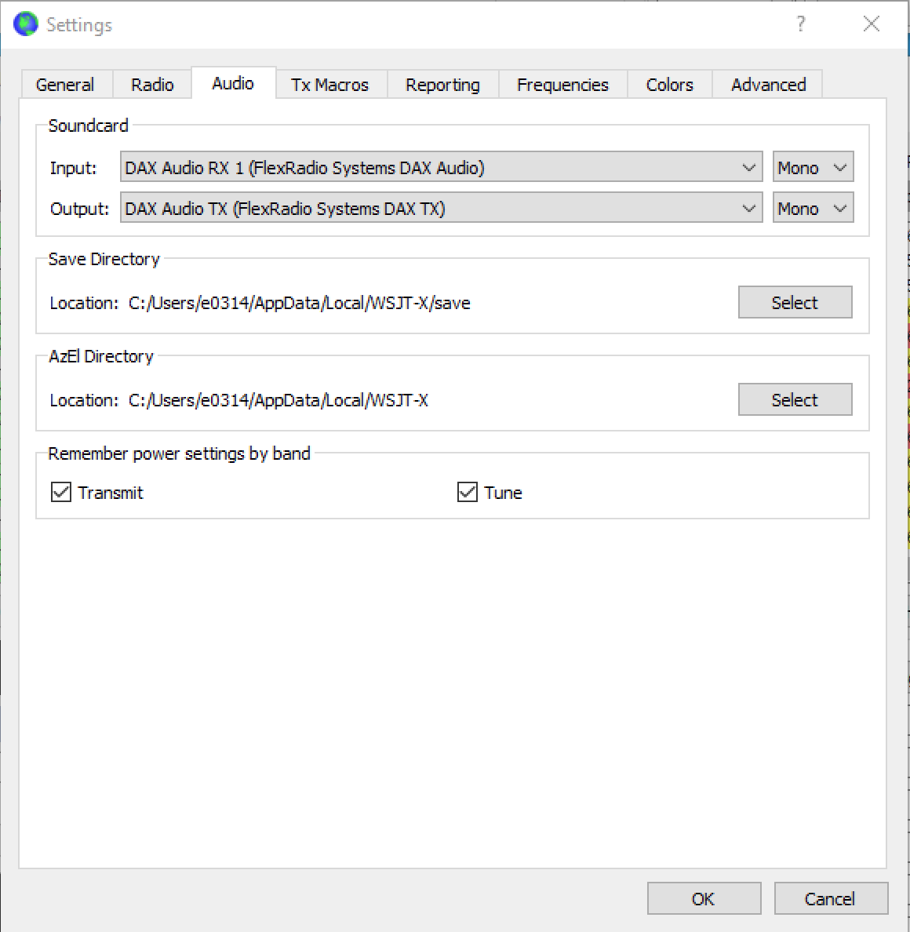
Configure Audio

Slide 31
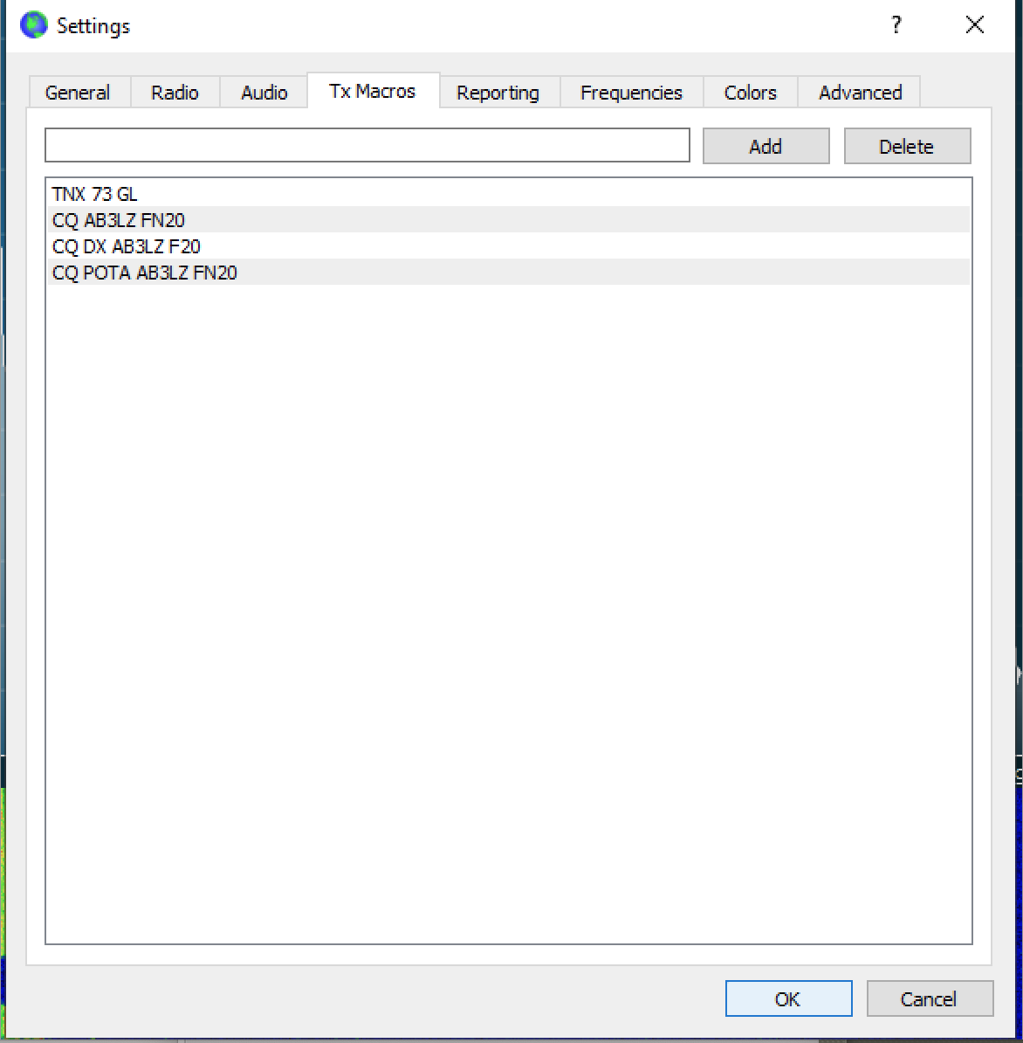
Define Tx Macros

Slide 32
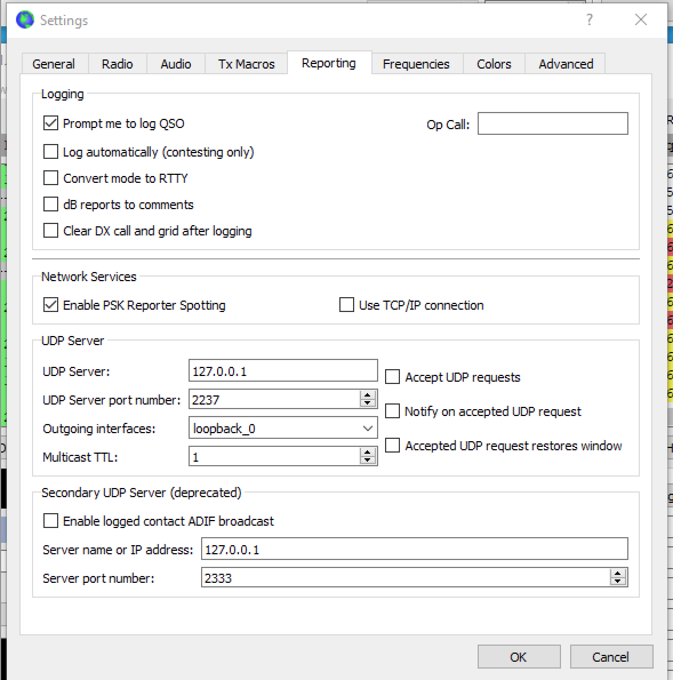
Reporting Settings

Slide 33
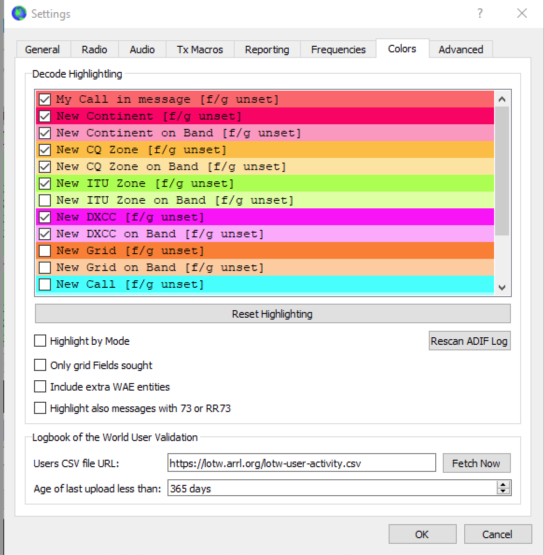
Color Settings

Slide 34
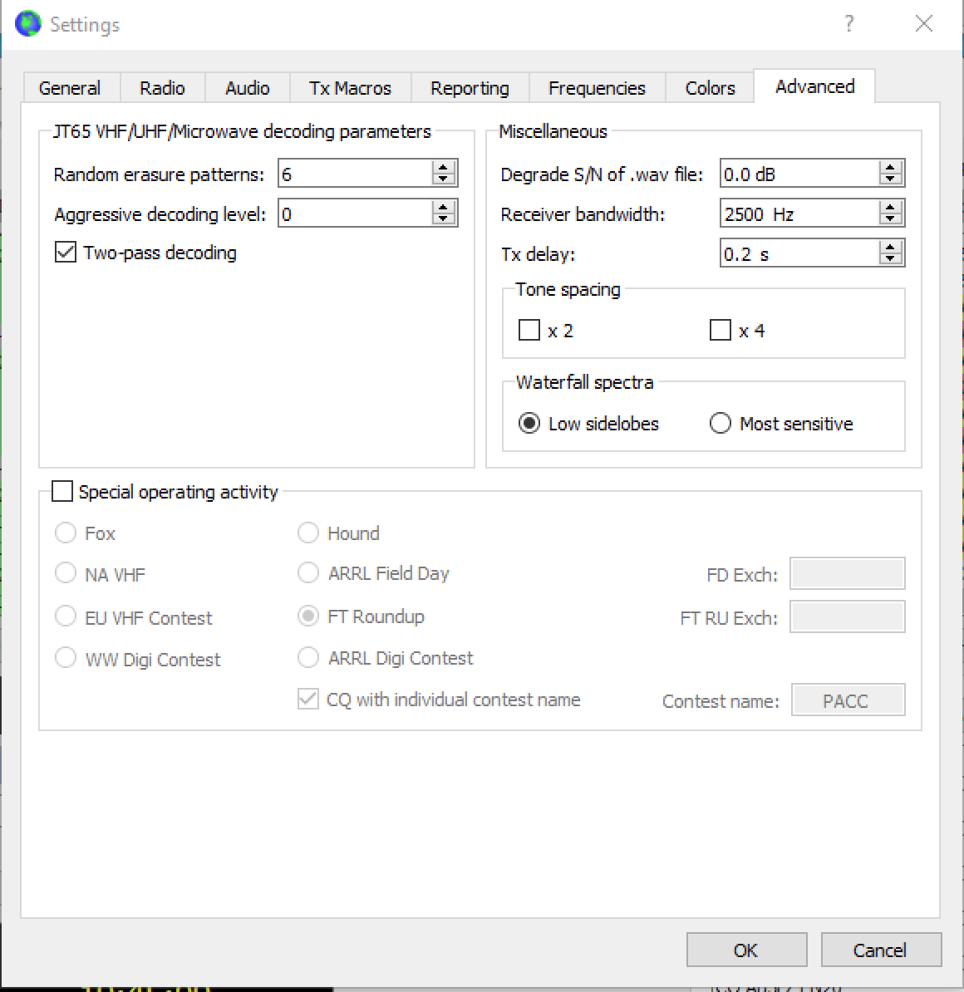
Advanced Settings

Slide 35
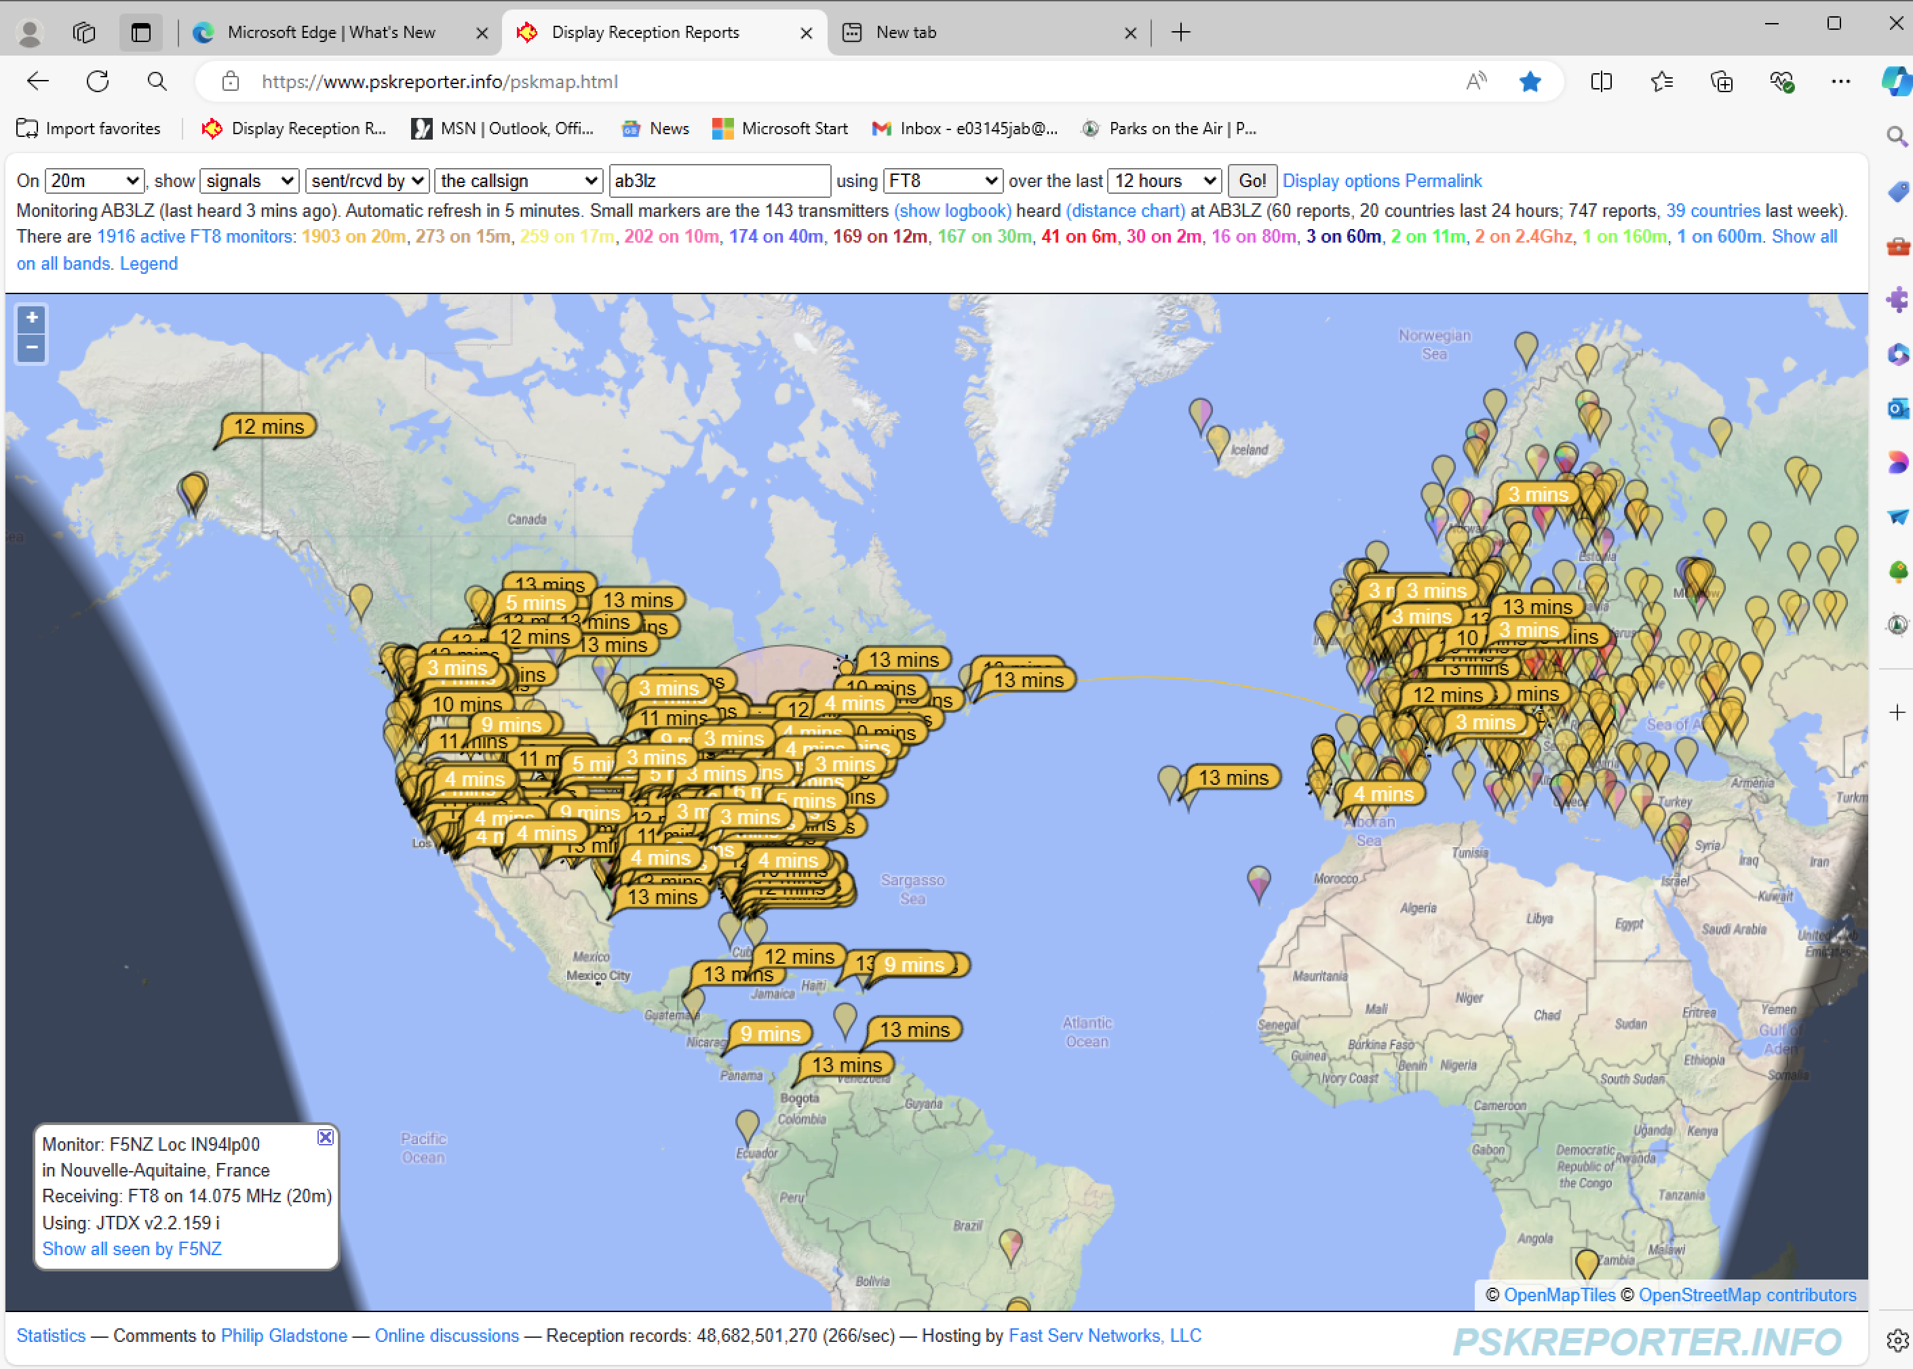
If you have an Internet Connection, You can Participate in the Reporting Network
http://pskreporter.info/pskmap.html

Slide 36
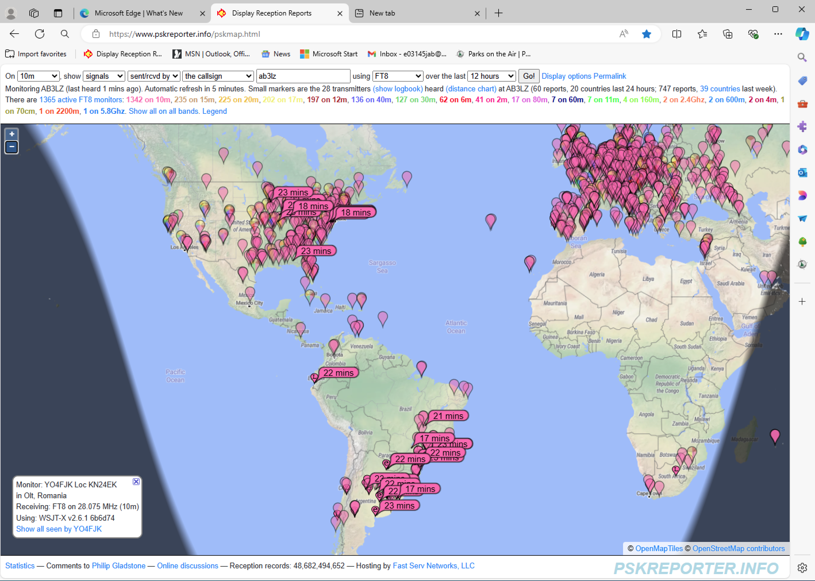
Signal on PSKReporter

Slide 37
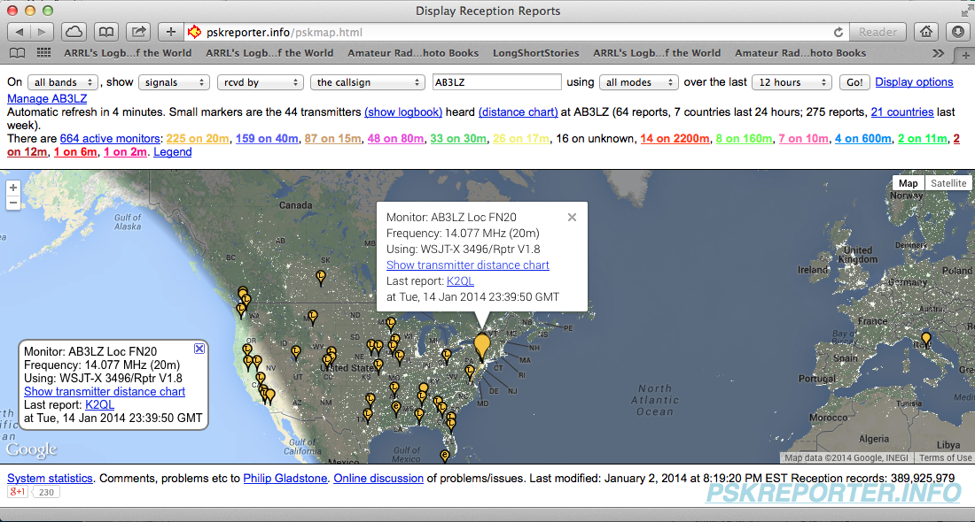
Stations I Monitored and Reported to pskreporter

Slide 38
What Is FT4?
Specifically for contesting.
Like FT8.
Uses a 6 second long T/R sequence.
2.5 times faster than FT8.
Uses 4 tone FSK.
Less sensitive than FT8.
Sensitivity down to -18 dB.

Slide 39
db Refresher
% Power = 100% X anti log (db/10)
% Voltage = 100% X anti log (db/20)
S/N Ratio with respect to power received:
0 db = 100% (signal power =100% of noise power)
-5 db = 31.6% (signal power =31.6% of noise power)
-10 db = 10% (signal power =10% of noise power)
-15 db = 3.1% (signal power =3.1% of noise power)
- 20 db = 1.0% (signal power =1.0% of noise power)
-25 db = 0.32% (signal power =0.32% of noise power)
-27 db = 0.2% (signal power =0.2% of noise power)

Slide 40
See You on FT8!
Questions and Comments

